Slide 1
Further development on the Moodle Code Hand-In Package
By Samuel Deane

Slide 2
Contents
Project Description
Background
Automated Assessment
Current Flinders Systems
Background – Existing systems
The previous project - ‘Code-Handin Modules for IDEs and Moodle’
Project Goals
Current progress
Still to-do / Future projects
Questions

Slide 3
Project Description
To continue development of a plugin/module for the Moodle Learning Management System (LMS) which will be integrated into Flinders’ own Moodle System, Flinders Learning Online (FLO), for use in future programming topics
Notes:
It’s a programming plugin
Or where programming knowledge is required
Flo is a Moodle

Slide 4
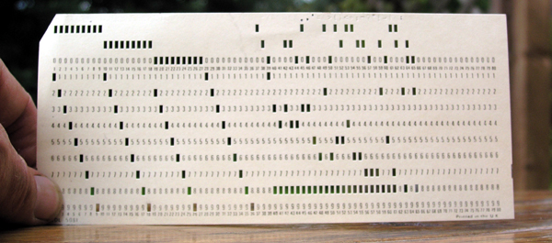
Background – Automated Assessments
As long has there have been computers there has been automated assessments
From punch cards of the 60’s
To the testing programs used in Flinders today in topics such as Computer programming 1, 2 and others
All aim to achieve two things
Frees those grading submissions from
mundane questions and tasks
Gives users instant feedback
Notes:
Too answer this question we need to first consider the background
prevents students struggling and generally being discontent and frustrated about programming

Slide 5
Background – Current Flinders Systems
Current systems
Computer programming 2
Application development
Networks / Networks and operating systems
Drawbacks
OS dependant
Not FLO integrated
Complex for the beginner
Notes:
Test programs given to the students to test against a specific task
Programming quiz questions automatically graded
Test programs outputs against expected in a set time frame
Flinders has been using and developing automated assessments for years
OS dependant – students have to SSH or remote login into the system
Not FLO integrated – grading is separate to FLO and grades have to be entered manually
Complex – some students find it difficult to setup the learning environment, see that as some achievement in itself

Slide 6
Background – Existing systems
Other similar Moodle based systems
CodeRunner
a moodle quiz plugin
Virtual Programing lab
a moodle module for programming assignments
Drawbacks
Module based,
Complicated,
limited or no web server included
Notes:
Oversights such as setting up programming software, testing devices … complications of operating systems and version compliance
chroot – cant access files outside its tree
Module based – don’t integrate with the assignment system, bulky
Lack of a web server makes them web interface only systems
Coderunner – not specific to the task

Slide 7
The previous project - ‘Code-Handin Modules for IDEs and Moodle’ 1 - Jonathan MacKenzie’s 2013 honours project
The initial solution
Integrate into Moodle as a module
Features:
Allows the submission, testing and automated grading of student programs from anywhere with client program
Drawbacks
Basic functions
Compilers are local
Not integrated with existing moodle modules … such as the assignment module
Architecture Developed
System
Client Side
Moodle Server Side
Moodle
Moodle web Interface
Codehandin module
Basic settings
Test results display
Tests and Submissions via client only
Client
Python
Client
Codehandin
Web service
Local
Compilers
Notes:
Moodle
A Open source e-Learning platform
FLO is the Enterprise Moodle for Flinders
Replacement for blackboard in 2012 due to support for blackboard ending last year (2013)
Written in PHP!
Used in over 230 countries!
Moodle HQ is based in Perth

Slide 8
Project Goals
Switch to a Moodle assignment submission/feedback plugin
IDE integration
NetBeans Clients for students and lectures
Better Sandboxing
Compare possible sandboxes
Expand Moodle Web interface
Documentation the process
Notes:
Moodle documentation - future plugin development at flinders
Mention Netspot, who manage flo for the uni

Slide 9
The Old to New Code Hand-In package architecture
System
System
Client Side
Moodle Server Side
Compiler System
Client Side
Moodle Server Side
Moodle
Moodle web Interface
Moodle
Codehandin module
Basic settings
Test results display
Tests and Submissions via client only
Moodle web Interface
Assignment Module
Client
Python
Client
Codehandin
Web service
Client
IDE (Netbeans)
Submission
Plugin
Feedback
Plugin
Java
Codehandin
Client for IDEs
Codehandin
Web Service
Shared lib
Remote Compiler
*
Local
Compilers
Local
Compilers
Local
Compilers
Old architecture
New architecture
Notes:
No longer a plugin or a module but a package of three distinct systems
Why the changes

Slide 10
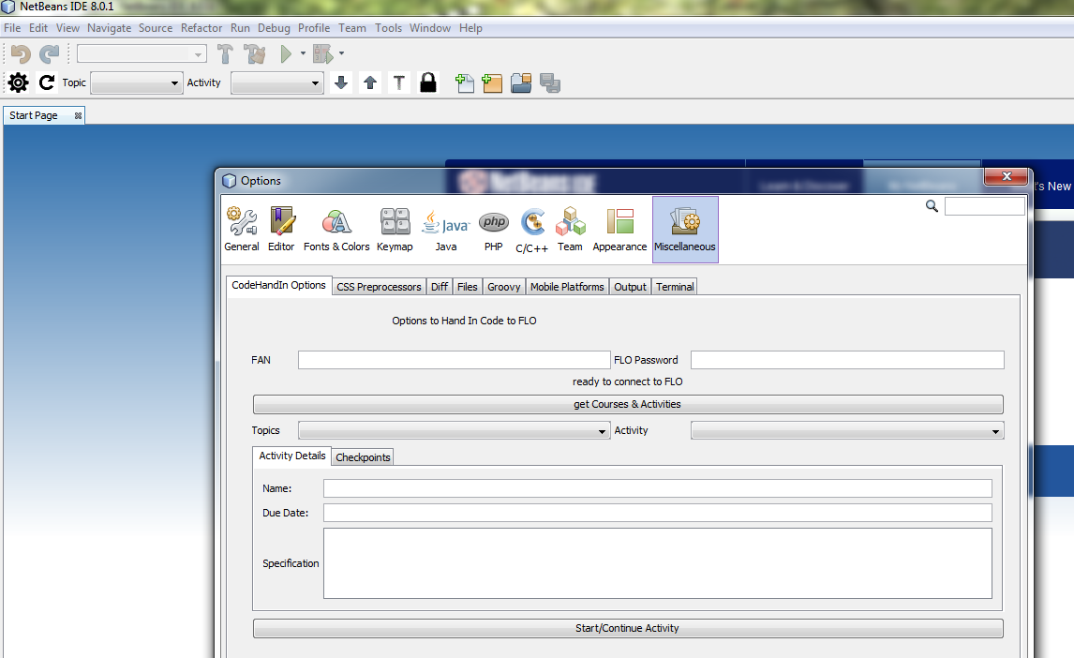
Netbeans Plugin

Slide 11
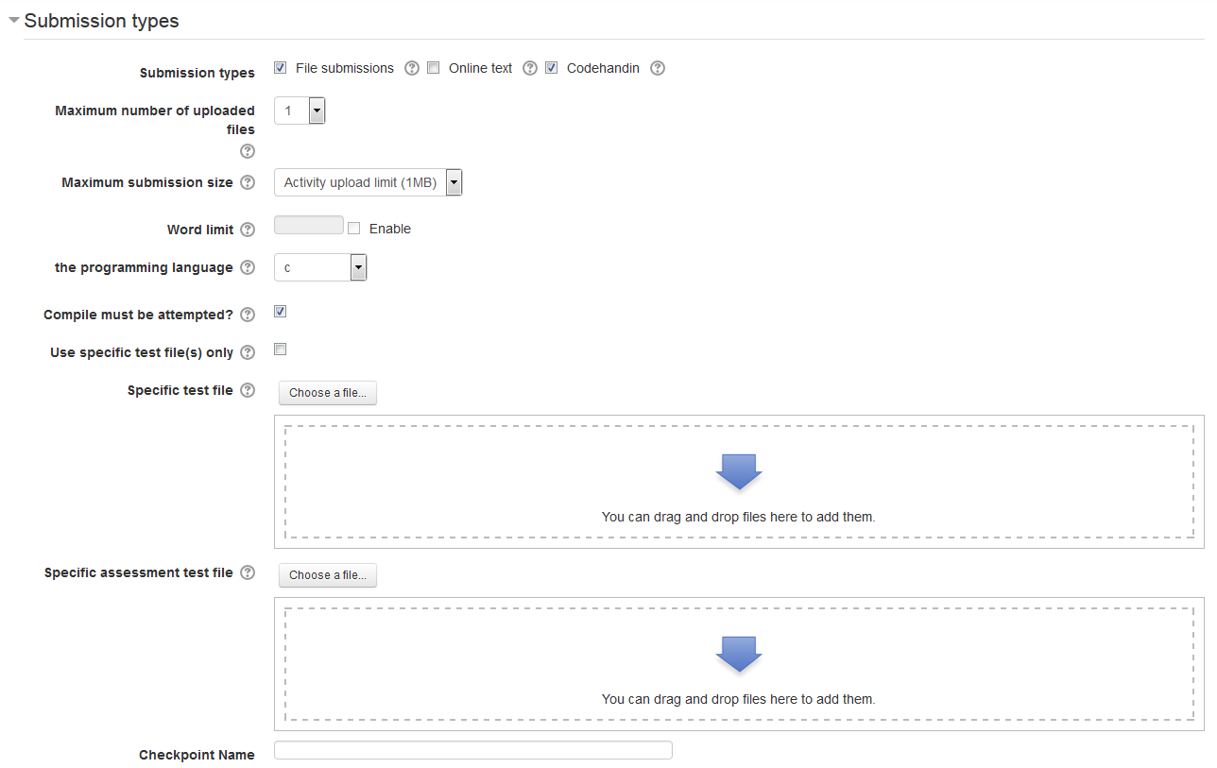
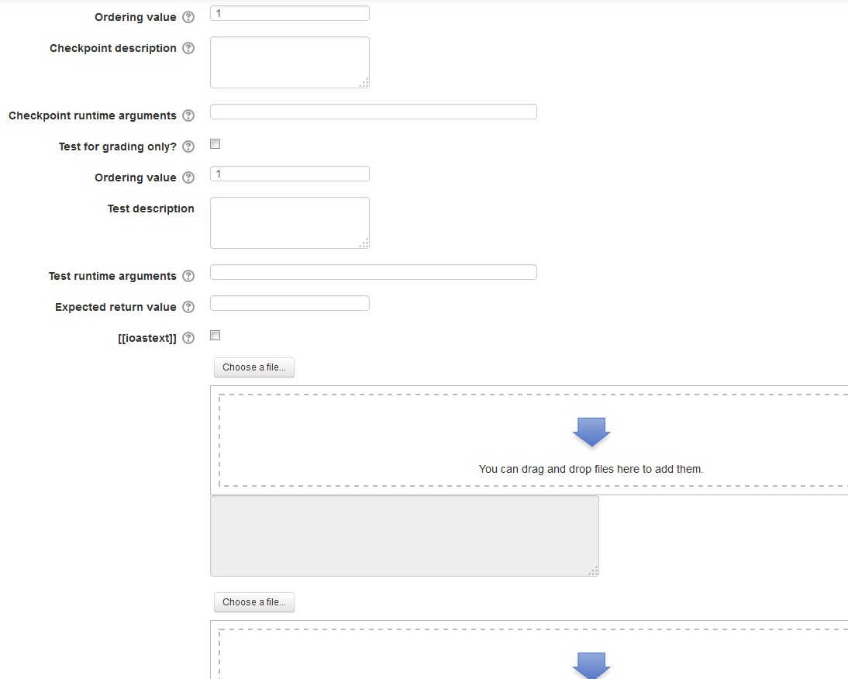
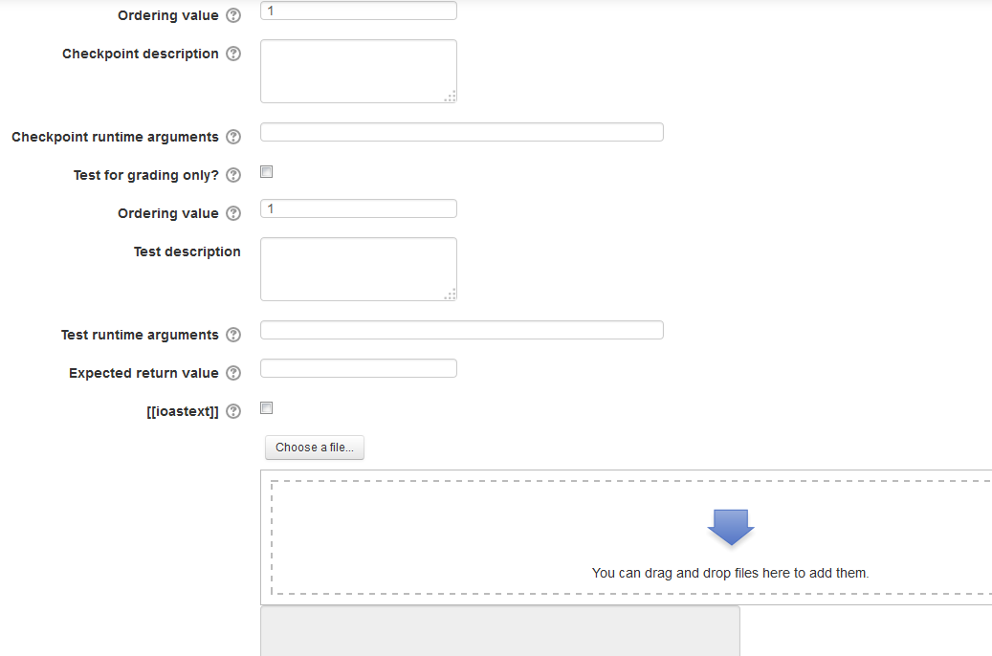
Moodle plugin

Slide 12
Other progress
Remote compiler chosen and setup
Using remoteinterview/compilebox
Codehandin library methods created
Web service methods expanded
Java IDE client two thirds done
Feedback plugin started
15+ pages of moodle plugin programming introduction
Notes:
Codehandin library methods – things like create test, checkpoints, zip files, send to web service

Slide 13
Still to-do / Future projects
Methods to pass client submission to compiler
Connect the Java client to the IDE plugin
Formalise the moodle submission and feedback plugins
Solaris/Unix or uni computers Client
Integration with CodeRunner perhaps
Notes:
Hope to have everything but the

Slide 14
Questions?

Slide 15
References
https://github.com/trampgeek/CodeRunner
https://github.com/remoteinterview/compilebox
http://vpl.dis.ulpgc.es/
Christopher Douce, David Livingstone, and James Orwell. Automatic test-based assessment of programming: A review. J. Educ. Resour. Comput., 5(3), September 2005. ISSN 1531-4278. doi: 10.1145/1163405.1163409. URL http://doi.acm.org/10.1145/1163405.1163409.

